Slide 1
How To Write A RFP/Scope of Service to Get the Results You Want
Florida Redevelopment Association 2011 Annual Conference

Slide 2
Session Overview
Your community wants to solicit professional services and you have to write the request. Do you need a Letter of Interest, Statement of Qualifications, or Request for Proposals? Does it really matter? Learn how to target the right services and how to write the best request for services to meet your needs. Hear varying perspectives from a local government purchasing representative, professional services consultants, and developer. You can make sure you never again ask for something in a request for services and don’t get what you need!

Slide 3
Session Presenters
Neale Stralow, RLA, AICP
WilsonMiller Stantec
Carrie Woodell, CFCM
City of Winter Park, FL
Jeffrey L. Oris, CEcD
Planning and Redevelopment Consultants, Inc.
Tom Harmer, Senior VP
The Pizzuti Companies

Slide 4
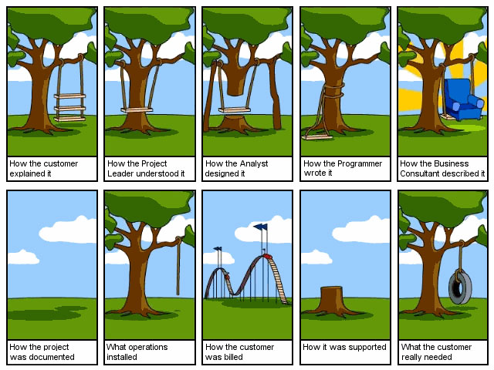
Varying Project Perspectives
Agency’s View of the Project

Slide 5
Project Manager
RFP Project Description

Slide 6
Consultant
RFP Project Response

Slide 7
Project Needed
What Really Was Needed

Slide 8
Community
Public Support of the Project

Slide 9
Panelist’s Perspectives
Purchasing Manager
Manager/Consultant
Development Related

Slide 10
Purchasing Manager’s Perspective
Florida Redevelopment Association 2011 Annual Conference
Carrie Woodell, CFCM, CPPO, C.P.M., FCPM
Purchasing Manager
City of Winter Park, FL

Slide 11
What Is An RFP?
Request for Proposal
Document: Formal invitation from an organization to a supplier to submit an offer
Process: in which the evaluators base the decision on more than price
Provides for the negotiation of all terms, including price prior to contract award
Evaluation based on criteria other than price alone
Experience; Qualifications; Proposed Solutions; Service After Award
Used to obtain “best overall value”
Discussion and revised offers permitted and encouraged (during negotiation phase)

Slide 12
What is an RFQ
Request for Qualifications
Qualification Based Selection
Florida State Statute 287.055 (CCNA)
Architects, Engineers, Landscape Architects, Surveying, Mapping Services
Basic construction exceeding CATEGORY FIVE ($325,000) F.S. 287.017
Planning or study activity exceeding CATEGORY TWO ($35,000) F.S. 287.017
Initial evaluation based on issues such as:
Project workload of firms
Professional personnel
Past performance
Certified minority business enterprise
External quality control reviews
Any other factors deemed applicable to the requirements

Slide 13
RFQ and CCNA
Price cannot be an evaluation criteria
No fewer than three firms may be short listed
Interviews/oral presentations
Negotiation (only) with the most qualified firm
Detailed analysis of the cost of professional services
If unsuccessful in negotiation, formal termination; proceed to second most qualified
Can not revisit after formal termination

Slide 14
Two Step RFP Processes
Offeror submittals in 2 separate sealed envelopes
Technical proposal
Price proposal
RFQ/RFP
Qualification based selection
RFPs to short listed firms

Slide 15
Building the RFP Document
Section I – Proposal Information
Standard terms & conditions
Section II – Scope of Work
Agency overview & background
Tasks required & deliverables
Scope of work
Minimum vendor qualifications
Section III – Proposal Content
Proposal format
Price/cost requirements

Slide 16
Building the RFP Document
Section IV – Evaluation Procedures
Criteria/points/ranking
Evaluation procedure
Selection process
Award process
Section V – Appendix
Attachments & exhibits
Standard agency agreement

Slide 17
Creating the Scope of Work
The MOST important step in the process
Most frequent cause for contract failure – unclear specifications
Establish performance standards and a contractual baseline
Provide the contractor with a basis of estimate
Communicate effectively
Identify the resource, schedule and compensation constraints
Identify specific technical data requirements such as plans, specifications, reports, etc.
Identify performance, quality and operational characteristics
Identify specific mandates or directives that may influence the contract (licenses, etc.)

Slide 18
Creating the Scope of Work
Text should be clear and free of vague terms
Use specific words to avoid misunderstandings
Shall: expresses a requirement binding on either party
Should/May: expresses a non-mandatory provision
Will: expresses a declaration of purpose on the part of the purchaser
Identify a minimum requirement
Allow for maximum competition

Slide 19
Creating the Scope of Work
Identifying Requirements
Review/modify last RFP issued
Research other agency proposals
Brainstorm with committee members/stakeholders
Identify new requirements
Request for Information (RFI)
Helpful for researching new & improved ideas

Slide 20
Section I – Proposal Information
Parameters of Submittal
Due date/time; number of copies; pre-proposal conference (mandatory/non-mandatory)
Standard Terms & Conditions
Special Terms & Conditions
Required Documents (bonds, insurance, licenses, warranty)

Slide 21
Section II – Scope of Work
Describe the type of work to be done
Initial general overview
Specific responsibilities
Describe anticipated results
Deliverables
Services rendered
Statement of Qualifications
Establishes an expected quality level for performance

Slide 22
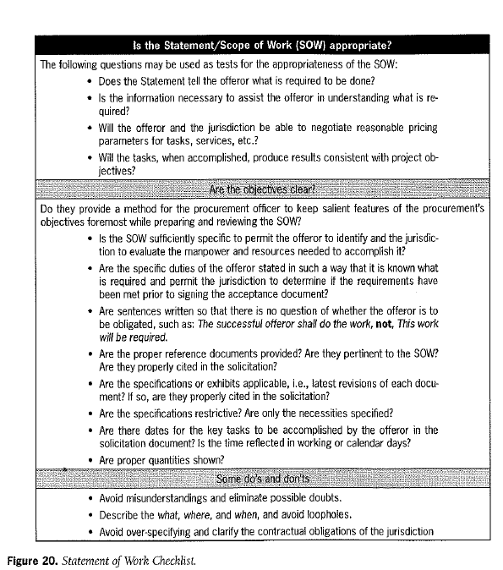
*Contracting for Public Sector Services (NIGP)

Slide 23
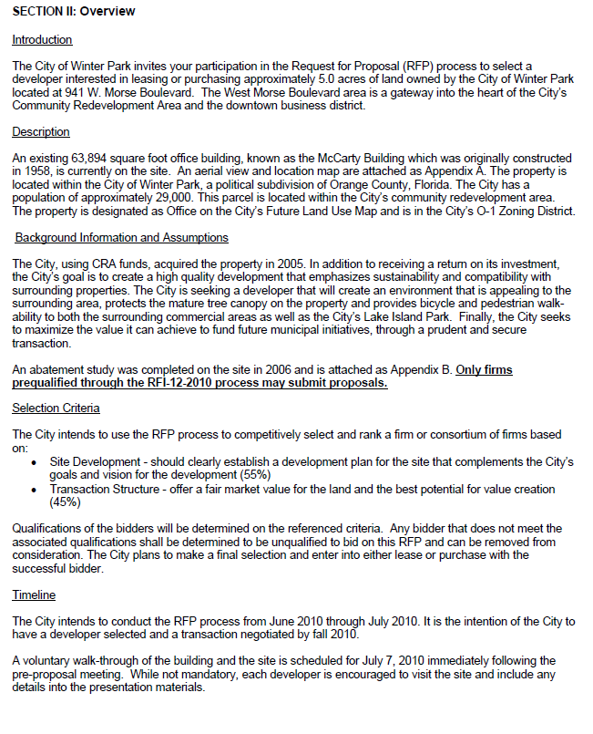

Slide 24
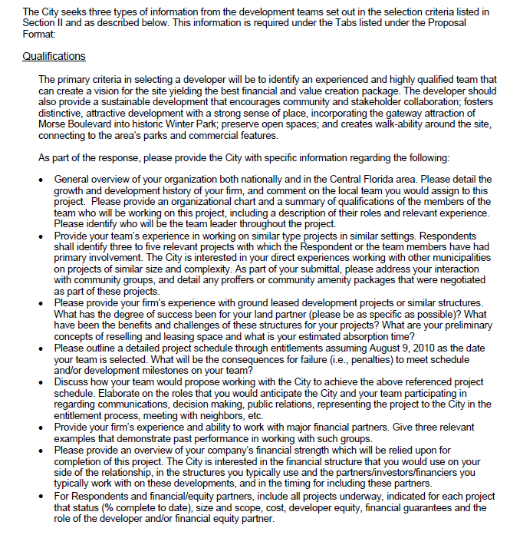

Slide 25
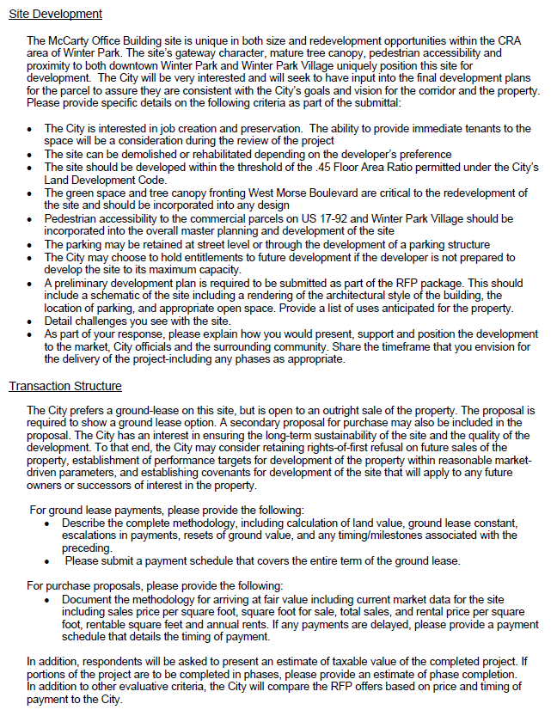

Slide 26
Section III – Proposal Content
Details how the vendors are to respond to the RFP
Number of copies
Bound copies vs. electronic
Confidential information?

Slide 27
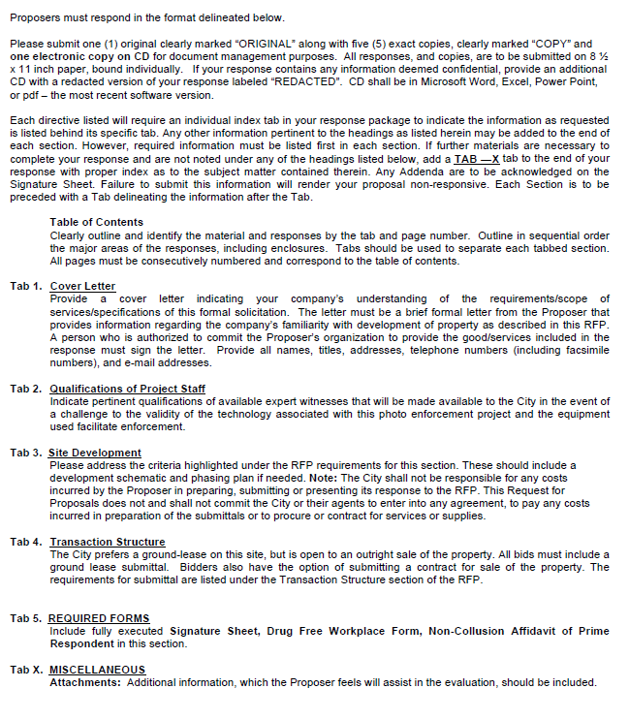

Slide 28
Section IV – Evaluation Procedures
Explain the process for evaluation
Identify criteria and weights
Provide timeline
Selection process
Interviews/Oral presentations

Slide 29
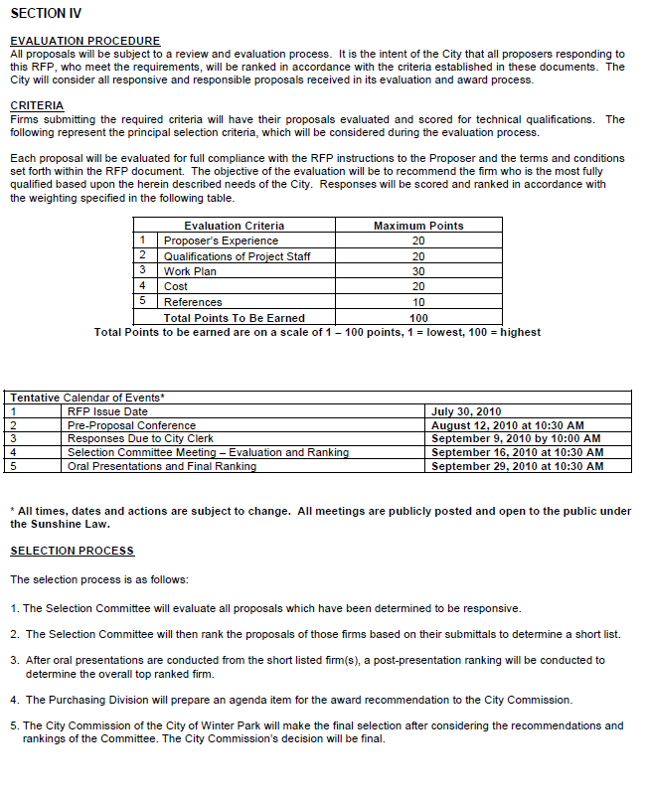

Slide 30
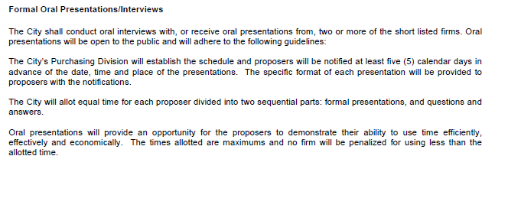

Slide 31
Section IV - Appendix
Useful tools to help proposers
Aerial View and Location Map
Abatement Study
Analytical Statements
Photographs or Site Layouts

Slide 32
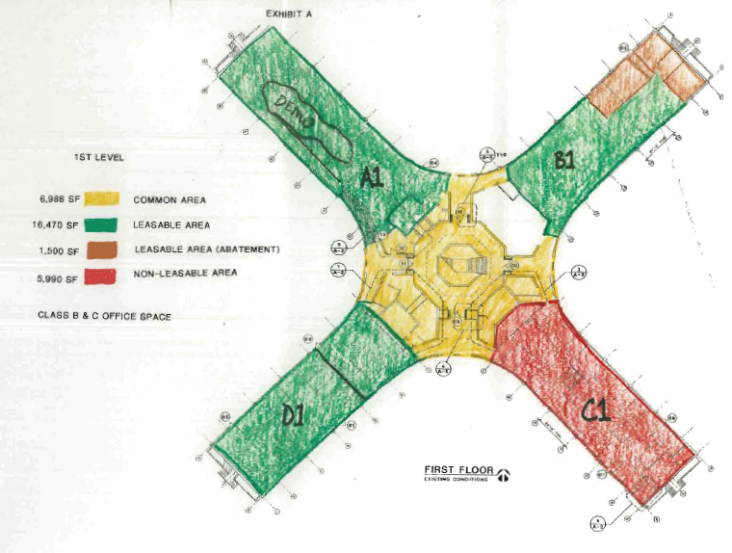

Slide 33
Keep in Mind
Compliance with procurement policies
Evaluation Committee
Blackout period
From date of RFP/RFQ issuance until date of award
May cause disqualification
Agency rule on rejecting proposals

Slide 34
Florida Statutes
Florida Statutes
119.071(1)(b) Public Records exemption
sealed bids, proposals or replies received by an agency pursuant to a competitive solicitation are exempt from s. 119.07(1) and s. 24(a), Art. I of the State Constitution until such time as the agency provides notice of an intended decision or until 30 days after opening the bids, proposals, or final replies, whichever is earlier.
Includes exemption if responses rejected with specific parameters
286.0113 Sunshine Law exemption
Negotiations, oral presentations, interviews; MUST be recorded. Recordings public upon intended award decision
Does NOT exempt evaluation meetings

Slide 35
When Questions Arise
Centralized through Purchasing
Ensures level playing field
Questions addressed in form of Addendum
Distributed to plan holders and posted
Must be acknowledged in proposal/response
May be cause for disqualification

Slide 36
Evaluation Committee
Typically 3-5 members
Selection Committee Guidelines
Adhere to public meeting requirements
Fair and objective evaluation of all proposals
Base evaluation on defined criteria
Proceedings will be recorded
All notes are public record

Slide 37
Debriefing
Gives offerors an explanation of the evaluation process, an assessment of their proposal in relation to the evaluation criteria, a general understanding of the basis of the award decision, and the rationale for their elimination from the competition;
Assists proposers in processing the experience;
Reduces the likelihood of protests;
Shows the evaluation was fair;
All documents are public record

Slide 38
Manager/Consultant Perspective
Florida Redevelopment Association 2011 Annual Conference
Jeffrey L. Oris, CEcD, President
Planning and Redevelopment Consultants, Inc.

Slide 39
What the Consultant Wants to See
Consultants seeks RFP’s to submit proposal on through a number of sources:
Demand Star
RFP Depot
Professional Organizations
Other Subscription Services
Registration with Each Government
Local Newspaper (the Old School Method!)

Slide 40
How the Consultant Finds Your Job
Seek for RFP’s by keywords:
Redevelopment
Master Plan
Study
Analysis
CRA
Economic
Vision

Slide 41
What the Consultant Wants to See
Critical to be concise and clear in the Title to your RFP… It should be short but:
Use good, simple keywords in the title.
Be clear and concise.
Convey the service your are seeking to contract.
Make certain your request is asking for the appropriate services and/or professionals.

Slide 42
What Service Do they Want?
TITLE OF THE REQUEST FOR PROPOSALS
PROFESSIONAL SERVICES FOR THE BRANDING AND ECONOMIC
RESTRUCTURING OF THE COMMUNITY REDEVELOPMENT AREA

Slide 43
What Service Do they Want?
Scope/Purpose
The intent of this project is to contract for professional services to implement the Redevelopment Plan and “Brand” the Downtown CRA in accordance with the Agency’s mission statement to “facilitate the emergence of a vibrant urban village where people of all ages will live, work, shop and be entertained.” The vision of the area recognizes the unique social and economic factors that are compressed in a relatively small area of the City. Policy 3.2.8 of the Redevelopment Plan is to “Brand the Core District as a well managed and organized urban destination for the purpose of drawing both visitors and residents to a broader market.” There are a number of existing retail and restaurant businesses in the Downtown area that through an economic restructuring process can be enhanced and expanded. Based on the success of these enterprises the CRA will be assisting in attracting new businesses to all the new developments.

Slide 44
What the Consultant is Looking for
Insurance Requirements
Timeline
Budget
Number of Public Meetings
Any Preferences in Contracting
When can I ask questions until
Is there a Pre-Proposal Conference
Is the pre-proposal mandatory?
When is the Proposal Due

Slide 45
What the Consultant is Looking for
Does this Request give me a sense that this government knows what it wants and how the job needs to be accomplished ?

Slide 46
The Red Flags !!!
The Request’s purpose is not really clear.
Dates/times in the RFP do not match.
The RFP is 59 pages long and the description of the services sought is 2 paragraphs.
Description does not include mention of necessary/required items.
No Deliverables Described.
The work is to rely on another study/plan that is not yet contracted for or completed.

Slide 47
The Red Flags !!!
Project Budget found/told does not match what consultant knows to be the project cost.
City/CRA has repeatedly hired the same firm for work and there does not appear to be any reason they would hire someone else.
A City/CRA/County where there has been difficulty before for consultants.
An RFP that reads like a bid… as if a commodity is being purchased.

Slide 48
The Red Flags !!!
A short timeline until submittals are due.
Specific requirements on who will be selected:
A firm within a geographic area when this is unnecessary.
Someone with specific knowledge of another study completed for the City/CRA.
Firm with specific specialties.
Description of activities which would require an Architect, Engineer or Land Surveyor.
Description of need for subcontractors that would provide unnecessary services.

Slide 49
Some of the Problems
A person unfamiliar with the project is the contact person.
No expectation I will get an answer to my question.
Will get the “technical answer” not desired answer.
Will get an insufficient answer to the question after it gets “lost in translation.”
Not a prime responsibility of a purchasing employee and thus not a priority.

Slide 50
Some of the Problems
A person unskilled with the purchasing prepares the Request/Bid
The desired scope will require an Architect, Engineer, or land surveyor and thus will violate the Consultants Competitive Negotiation Act (CCNA).
The wrong format will be utilized (i.e. request for a price in a Request for Interest).

Slide 51
Some of the Problems
Scope That is Too Expansive/Not Expansive Enough:
Asks for one service and describes unrelated services to be included.
Does not give sufficient time to complete services desired.
Does not include description of services Consultant knows to be needed.

Slide 52
Some of the Problems
The Selection Process is not handled well.
Selection committee not set prior to request’s release.
No selection timeline prepared prior to request’s release.
Too many respondents asked to make a presentation.

Slide 53
Things I Don’t Want to Deal With
The War & Peace-sized version of your City/CRA History.
The contract/agreement you will want me to sign.
Filling out forms you don’t need yet.
Trying to find a Scope of Work/Description of the Job on page 39 of 59.
A City/CRA that clearly does not know what it wants or what is required for the job to be completed.

Slide 54
Things to Avoid
Monday deadlines
Early morning submittal deadline.
Use of only a PO Box for submittal mailings.
The person assigned as contact goes on vacation between release date and due date of the RFP.
The stated contact person no longer works for the City/CRA.

Slide 55
How to Get it Right…
Just put yourself in the Consultant’s shoes….
Does this Request tell me what they want?
Are the submittal requirements clearly listed?
How long will this take to put together?
Have they made the selection process clear and does it make sense for me?
Does the government seem to have their stuff together and understand what they are asking for?
What is my anticipated return on my investment of time, effort and money?

Slide 56
Development Related RFP’s and RFQ’s
Florida Redevelopment Association 2011 Annual Conference
Tom Harmer, ICMA-CM, Senior Vice President
The Pizzuti Companies

Slide 57

An Initial Thought
“If you don’t know where you are going, any road will get you there.”
Lewis Carroll

Slide 58
Soliciting a Developer
Developer selection is often initiated through a Request for Qualifications (RFQ) or Request for Proposals (RFP).

Slide 59
Purpose of Developer RFP/RFQ
Tool to achieve a public goal
Introduces competition in a redevelopment project
Helps to ensure a qualified development partner is selected
Marketing tool to attract private development

Slide 60
Before RFP / RFQ Process
Gain Political Consensus on Project Concept, Objectives and Range of Possible Incentives
Detailed understanding of project feasibility is important.
Understanding of incentives that may be offered is also critical.
Casting a wide net is not always effective. Specificity is key.
DON’T LEAVE THIS UP TO THE DEVELOPER OF CONSULTANT!
Have Understanding of Bidding Laws, Requirements and Confidentiality
Identify Lead Agency, Selection criteria, and Selection Process (RFQ/RFP, RFP…)

Slide 61
A Certain Flexibility
The RFP should demonstrate a way for the developer to participate and realize a return on investment,
AND
Encourage the developer to respond with even better way to participate and realize public and private objectives.
Overly complicated requirements will limit qualified responses, especially in good economic times.

Slide 62
Public Private Partnerships: Lessons Learned
Need a Political Champion
Communicate, Communicate, Communicate…
Involve Stakeholders
RFQ/RFP Process is Slow…May Miss Market
Private Developer is Partner…Not Adversary
Banks Will Want Changes in Development Agreement
Its Not Done Until You Move Dirt, Then Its Still Not Done

Slide 63

Do’s and Don’ts
Don’t be Swayed by Beautiful pictures
Don’t go on a Fishing Expedition
Do Understand the Market
Do make Your RFP Requirements Reasonable
Do Proceed only With Political Support
Do Visit the Developer’s Projects
Do Call References to Understand Past Performance
Do Proof Read Your Request

Slide 64
RFP & RFQ Examples
Language From RFP/RFQ Documents:
“The City may, in its sole discretion and without any obligation to act reasonably, reject any and all proposals, negotiate with any entity submitting a proposal, waive any formalities connected therewith, extend deadlines, request additional information …”

Slide 65
RFP & RFQ Examples
From a document issued as an RFP:
“(The organization) discourages lengthy submittals” Required components:
- Transmittal letter - Developer information - Development team - Proposed associate members - Developer experience - Developer history, financial position & abilities - Other (participation with minority-owned businesses; approach to worksite safety …)

Slide 66
RFP & RFQ Examples
Required components (continued):
- Technical approach - Project understanding
- Project approach
- Project management approach
- Project staffing approach - Other (participation with minority-owned businesses; approach to worksite safety …) AGAIN?

Slide 67
RFP & RFQ Examples
From the same document …
Response due date: October 8
Development team to recommend award:
Late October
Agreement finalization:
“Officers will meet with the successful development team between September 28 and October 5.”

Slide 68
RFP & RFQ Examples
From an RFP Seeking a Developer:
Confidentiality Due to the competitive nature of the RFP evaluation, negotiation and selection process, and the fact that subsequent submissions will likely be required of two or more Proposers, in order to obtain best and final offers, and finally the fact that proposals will involve the negotiation of a real estate transaction…

Slide 69
Still Going…
… and contain information relating thereto, involving trade secrets, commercial and financial information, the disclosure of which could cause substantial competitive harm to the Proposers and the interest of the College until the College completes it negotiations and contract execution with the successful Proposer, any public release of the Project information from specific proposals, is prohibited.

Slide 70

You Didn’t Hear It From Me…
From a Redevelopment RFP:
Neither the City, nor (owner’s agent), nor any their officers, agents or employees, shall be responsible for the accuracy or completeness of any information provided to any Developer as part of the RFP or clarifications to the RFP. All Developers are encouraged to independently verify the accuracy of any information provided by the City or (the owner’s agent) or obtained from any other source. The use of any of this information in the preparation of a response to this request is at the sole risk of the Developer.

Slide 71

How Much is Too Much?
(The city) seeks useful and quality information about the proposer – as well as capacity to provide the required services for a successful project. Vague and redundant discussions are not desirable, nor is a bulky display of irrelevant information. A carefully prepared, graphically attractive submittal will be most appreciated.

Slide 72

How Much is Too Much?
Continued:
… you are encouraged to be brief and succinct. Thick volumes of background and general marketing material will not be appreciated and will not curry favor with the reviewers.
And:
PLEASE NOTE THAT QUALIFICATIONS WILL BE EVALUATED ON CONTENT, NOT BULK!

Slide 73

Did I Really Say That?
Unnecessarily elaborate responses beyond that sufficient to present a complete and effective response to this solicitation are not desired and may be construed as an indication of the respondent’s lack of ability to communicate in a cost-effective and succinct manner.

Slide 74

Do the Math
Please submit:
Nine (9) copies of between three (3) and five (five) Consultant Verification Forms.
(Between 3 and 5? Could that be 4?)

Slide 75

Do I Need To Go To The Pre-Bid?
Non-mandatory pre-submittal conference and mandatory site visit at the same time at the same location.
Seems to me you go to one, you’re already at the other…
Pre-proposal conference
The County will hold a pre-proposal conference and mandatory site visit on Thursday, October 20, 2011 at 10 a.m. EST. Attendance at the pre-proposal conference is voluntary for responding to this RFP, however, responses of proposers who fail to attend the site visit will not be considered. The purpose of the pre-proposal conference is to provide information regarding the project and to address any questions and concerns regarding the services sought by the county through this RFP.

Slide 76
A Final Thought
“Never tell people how to do things.
Tell them what you want to achieve and they’ll surprise you with their ingenuity.”
General George S. Patton

Slide 77
Collective Takeaways
Florida Redevelopment Association 2011 Annual Conference
Neale Stralow, RLA, AICP
WilsonMiller Stantec

Slide 78
Big Items
Define The Project Needs
Legal Requirements
Reduce Documentation
Internal Consistency
Identify Knowledgeable Contact Person
Allow For Innovation

Slide 79
Questions & Answers Please Fill Out The Evaluation Surveys
Florida Redevelopment Association 2011 Annual Conference
You may reach us at: neale.stralow@stantec.com jeff@parconsultantsinc.com
cwoodell@cityofwinterpark.org
tharmer@pizzuti.com

Slide 80
How To Write A RFP/Scope of Service to Get the Results You Want
Florida Redevelopment Association 2011 Annual Conference

